Slide 1
SET AND LOGICAL OPERATORS

Slide 2
SET OPERATIONS-
UNION, INTERSECTION, MINUS, COMPLEMENT
Sets represent objects (regions) in a binary image
Region
Let R be a subset of pixels in an image, we call R a region of the image if R is a connected set.
Boundary
The boundary (also called border or contour) of a region R is the set of pixels in the region that have one or more neighbors that are not in R.
Elements of the sets are the (x, y) coordinates of those objects
To know whether two objects, A and B, of a binary image overlap , compute AՈB
If the result is not the empty set, then some of the elements of the two objects overlap.
Set operations are meaningful for binary images.
Union, Intersection, Complement, Minus

Slide 3
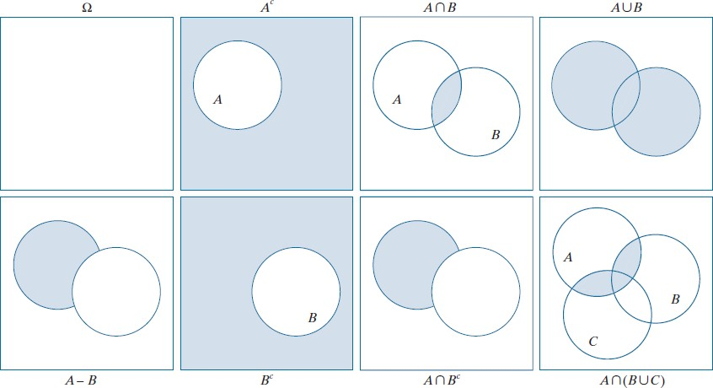
SET OPERATIONS - VENN DIAGRAM REPRESENTATION

Slide 4
SET OPERATIONS FOR GRAY SCALE IMAGE
Grayscale set operations are element wise operations
Union operation – Maximum of corresponding pixels
Intersection operation – Minimum of corresponding pixels
Complement operation – is the pairwise differences between a constant and the intensity of every pixel in the image.

Slide 5
COMPLEMENT OPERATION FOR GRAY SCALE IMAGE
Elements of a gray scale image - set A
triplets of the form (x, y, z),
- elements are
where x and y are spatial coordinates, and z denotes
intensity values.
Complement of A is the set which is the set of pixels of A
whose intensities have been subtracted from a constant K.
This constant is equal to the maximum intensity value in the image, 2^{k} − 1, where k is the number of bits used to represent z.

Slide 6
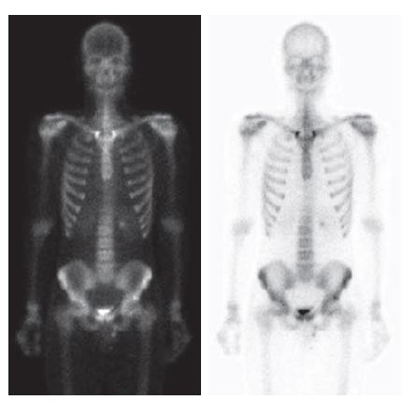
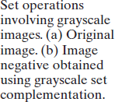
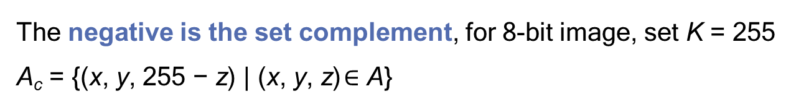
COMPLEMENT OPERATION- NEGATIVE OF THE IMAGE
The negative is the set complement, for 8-bit image, set K = 255
A_{c} = {(x, y, 255 − z) | (x, y, z) $∈$ A}

Slide 7

UNION OPERATION
The union of two gray scale sets A and B with the same number
of elements is defined as the set
If A and B are gray scale images of the same size, the union is an array formed from the maximum intensity between pairs of spatially corresponding elements.

Slide 8
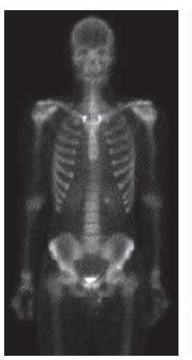
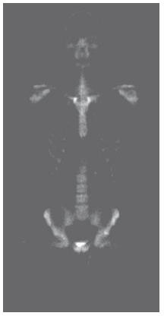

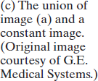
UNION OPERATION
A - original image
(B) - denote a rectangular array of the same size as A, but in which all values of z are equal to 3 times the mean intensity, z, of the elements of A.
Union operation - is the result of performing the set union, in which all values exceeding 3z appear as values from A and all other pixels have value 3z, which is a mid-gray value.
(a)
(c)

Slide 9
LOGICAL OPERATIONS
Logical operations deal with TRUE
(typically denoted
by 1) and FALSE
(typically denoted by 0)
variables and
expressions.
Binary images
composed of
foreground (1-valued) pixels, and
a
background composed of 0-valued pixels.

Slide 10
SET AND LOGICAL OPERATORS - APPROACHES ON BINARY IMAGES
Set and logical operators on binary images use one of two basic approaches:
we can use the coordinates of individual regions of foreground pixels in a single image as sets,
Or
we can work with one or more images of the same size and perform logical operations between corresponding pixels in those arrays.

Slide 11
APPROACHES ON BINARY IMAGES (CONTD.)
In the first category, a binary image can be viewed as a Venn diagram in which
the coordinates of individual regions of 1-valued pixels are treated as sets. The union of these sets with the set composed of 0-valued pixels comprises the set universe, A.
Given a binary image with two 1-valued regions, R1 and R2 , we can determine if the regions overlap (i.e., if they have at least one pair of coordinates in common) by performing the set intersection operation R1 Ո R2
In the second approach, we perform logical operations on the pixels of one binary image, or on the corresponding pixels of two or more binary images of the same size.

Slide 12
APPROACHES ON BINARY IMAGES (CONTD.)
When applied to two binary images, AND and OR operate on
pairs of corresponding pixels between the images.
They are element wise operators in this context.
The operators AND, OR, and NOT are functionally complete, in the sense that they can be used as the basis for constructing any other logical operator.

Slide 13
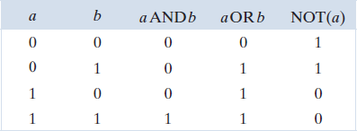
LOGICAL OPERATIONS- TRUTH TABLE

Slide 14
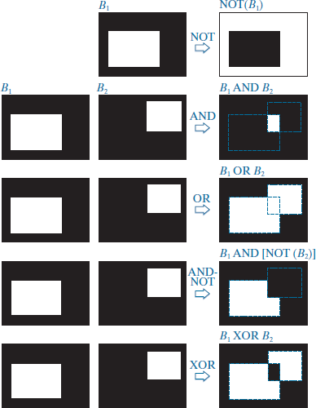
LOGICAL OPERATIONS
The NOT of binary image B1 is an array obtained by changing all 1-valued pixels to 0, and vice versa.
The AND of B1 and B2 contains a 1 at all spatial locations where the corresponding elements of B1 and B2 are 1; the operation yields 0’s elsewhere.
OR of these two images is an array that
contains a 1 in locations where the
corresponding elements of B1, or B2 , or both, are 1. The array contains 0’s elsewhere.
The result in the fourth row corresponds to the set of 1-valued pixels in B1 but not in B2.
The last row is the XOR (exclusive OR) operation, which yields 1 in the locations where the corresponding elements of B1 or B2 , (but not both) are 1.

Slide 15
ACHIEVING SET OPERATIONS USING LOGICAL OPERATIONS
A_{c} = NOT(B1)

Slide 16
LOGICAL OPERATIONS – RESULTS BY FIRST APPROACH
Label the individual 1-valued regions in each of the two images
(in this case there is only one such region in each image).
Let A and B denote the set of coordinates of all the 1-valued pixels in images B1 and B2 ,respectively.
Then we form a single array by OR ing the two images, while keeping the labels A and B.
The result would look like the array B1ORB2 but with the two white regions labeled A and B.
In other words, the resulting array would look like a Venn diagram.

Slide 17





ARITHMETIC AND LOGIC OPERATIONS
a
b
NOT(a)
a . b
a + b

Slide 18
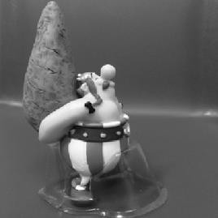

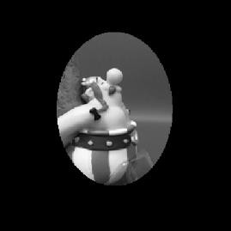

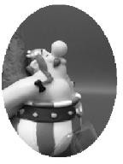
ARITHMETIC AND LOGIC OPERATIONS
.
=
+
=

Slide 19
THANK YOU

